Slide 1
Data Structures and Algorithm
COURSE CODE: CS-201
TOPIC: ARRAYS
COURSE INSTRUCTOR: HABIBA ARSHAD

Slide 2
CLO Covered
CLO2: Apply and design various data structures methods for specified applications.

Slide 3
Inserting and Deleting an Element
Insertion: Adding an element
  Beginning
  Middle
  End
Deletion: Removing an element
  Beginning
  Middle
  End

Slide 4
Insertion in Array
Inserting an element at the “end” of a linear array can be easily done provided the memory space allocated for the array is large enough to accommodate the additional element.
On the other hand, suppose we need to insert an element in the middle of the array. Then, on the average, half of the elements must be moved downward to new locations to accommodate the new element and keep the order of the other elements.

Slide 5
Insertion
1 | Brown
2 | Davis
3 | Johnson
4 | Smith
5 | Wagner
6
7
8
1 | Brown
2 | Davis
3 | Johnson
4 | Smith
5 | Wagner
6 | Ford
7
8
Insert Ford at the End of Array

Slide 6
Insertion
1 | Brown
2 | Davis
3 | Johnson
4 | Smith
5 | Wagner
6
7
8
1 | Brown
2 | Davis
3 | Johnson
4 | Smith
5
6 | Wagner
7
8
1 | Brown
2 | Davis
3 | Johnson
4
5 | Smith
6 | Wagner
7
8
1 | Brown
2 | Davis
3
4 | Johnson
5 | Smith
6 | Wagner
7
8
Ford
Insert Ford as the 3rd Element of Array
Insertion is not Possible without loss of data if the array is FULL

Slide 7
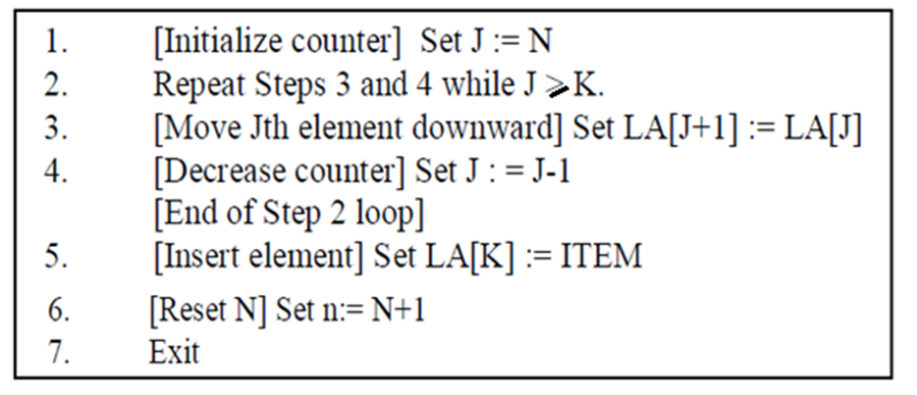
Insertion Algorithm
Algorithm inserts a data element ITEM into the Kth position in a linear array LA with N elements i.e. INSERT(LA,N,K,ITEM).
Here LA is a linear array with N elements and K is a positive integer such that K<=N. This algorithm inserts an element ITEM into the Kth position in LA.

Slide 8
Time Complexity
The running time for inserting an element in an array depends on
where you are inserting it:
At the End: If you're inserting at the end of the array, the time complexity is O(1), because you simply add the element without shifting any other elements.
At the Beginning or Middle: If you're inserting at the beginning or any position in the middle, the time complexity is O(n), where n is the number of elements in the array. This is because you need to shift all subsequent elements one position to the right to make space for the new element.

Slide 9
Deletion
1 | Brown
2 | Davis
3 | Ford
4 | Johnson
5 | Smith
6 | Taylor
7 | Wagner
8
1 | Brown
2 | Davis
3 | Ford
4 | Johnson
5 | Smith
6 | Taylor
7
8
Deletion of Wagner at the End of Array

Slide 10
Deletion
1 | Brown
2 | Davis
3 | Ford
4 | Johnson
5 | Smith
6 | Taylor
7 | Wagner
8
1 | Brown
2
3 | Ford
4 | Johnson
5 | Smith
6 | Taylor
7 | Wagner
8
1 | Brown
2 | Ford
3
4 | Johnson
5 | Smith
6 | Taylor
7 | Wagner
8
1 | Brown
2 | Ford
3 | Johnson
4
5 | Smith
6 | Taylor
7 | Wagner
8
Deletion of Davis from the Array

Slide 11
Deletion
1 | Brown
2 | Ford
3 | Johnson
4 | Smith
5 | Taylor
6 | Wagner
7
8
No data item can be deleted from an empty array

Slide 12
Algorithm for deletion-Steps
Underflow
Find location of element
Reorganize the whole array

Slide 13
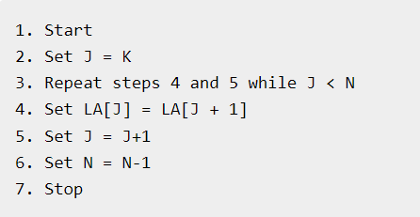
Deletion Algorithm
The following algorithm deletes the Kth element from a linear array LA and assigns it to a variable ITEM i.e. DELETE(LA,N,K,ITEM).
Here LA is a linear array with N elements and K is a positive integer such that K<=N. This algorithm deletes the Kth element from LA.

Slide 14
Time Complexity
The running time for deleting an element in an array, like insertion, depends on its position:
From the End: Deleting from the end is O(1) because you simply remove the last element without needing to shift any other elements.
From the Beginning or Middle: Deleting from the beginning or any position in the middle is O(n), where n is the number of elements in the array. This is because you need to shift all subsequent elements one position to the left to fill the gap left by the removed element.

Slide 15

Questions?

